Slide 1
CSD 1451
Week 2

Slide 2
Systems Thinking
Notes:
GDD Bible != Feature

Slide 3
What is it?
Thinking of things as systems
Systems consists of entities and their relationships.
Framework used to understand complex systems
Abstraction
Interactions

Slide 4
What we need to do
Identify the system, form and function
Identify the entities that make up the system
Identify relationships between entities
Predict and understand emergence

Slide 5
Function
What a system does, changes it brings

Slide 6
Examples of Function
The function of a bicycle is to transport a person
The function of a knife is to cut something
The function of an helicopter is to bring people/cargo to different places

Slide 7
Function – 2 Parts
Process
To bring about change
Operand
The thing that changes

Slide 8
Function
How systems create benefit
Emergence occurs in the functional domain
That special function that comes from your system

Slide 9
Form
What a system is

Slide 10
Form
Physical / Informational embodiment of a system
In your case, how you structure your code
It is the instrument of function
Function requires a form for execution

Slide 11


Form
E.g. Food delivery as a function, can take the forms of delivery drivers on e-bikes, cars or bicycles.

Slide 12
Value
Benefit at cost

Slide 13
Value
Benefit
Comes from function
Cost
Comes from form

Slide 14
Value of a Game
Benefit? What function does the game provide?
Cost? What form does the game come in?

Slide 15
Technical Decision Making
Your games need certain functionalities and systems (Benefit)
The way you implement those features is its form (Cost)
How do you get the greatest value from form and function?

Slide 16
Entities
Parts that make up the system
(Different from ECS)

Slide 17
Entities
Has form and function
Decomposition
Systems and entities can be broken down into smaller entities
Composition
Entities make up a system

Slide 18
(Aside) Architecture Paradigms
Composition
Object owned by parent destroyed when parent is destroyed
E.g. Enemy HP variable within enemy is destroyed together with the Enemy Object
Aggregation
Object can exist without the parent
E.g. Enemy Object destroyed, weapon used by enemy drops and can be used by player or other enemy.

Slide 19
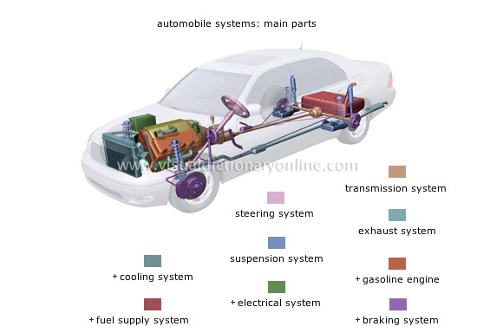
Entities – Of a Car
Tires
Steering wheel
Air Conditioning
Signaling system
Braking
Engine
Etc…..
Image source : http://www.visualdictionaryonline.com/transport-machinery/road-transport/automobile/automobile-systems.php
Notes:
So is this composition or aggregation?

Slide 20
Boundaries
For Healthier Systems and You

Slide 21
System Boundaries
Start by identifying the minimum number of essential entities.
Essential = Required to deliver the function of the system
Try to keep the number of entities to cognitive limits
7 +/- 2
Think holistically, produce all possibilities, then reduce to essentials

Slide 22
3 Categories of Entities
In the system
Essentials for emergent function
In the context
Not in the system but affects emergent function
E.g. external control
Temporarily Suppressed
Non-essential now, but may be important in the future

Slide 23
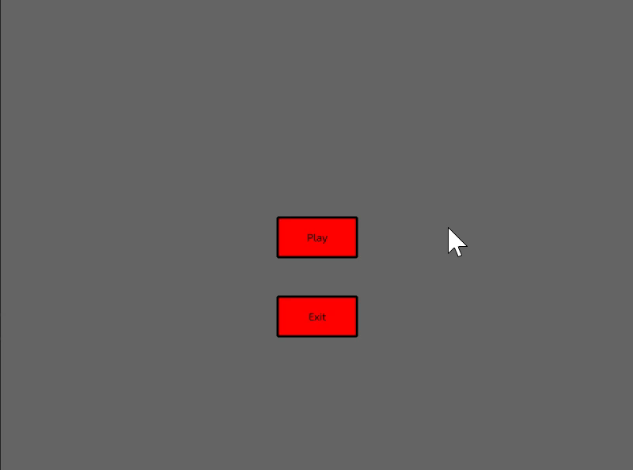
Case Study : Car Select Game
Decompose CSG into its entities
Focus on what is important, reduce entities
Categorize remaining entities
In the system
In the context
Temporarily suppressed

Slide 24
Case Study : Game Of Life
Decompose GOL into its entities
Focus on what is important, reduce entities
Categorize remaining entities
In the system
In the context
Temporarily suppressed

Slide 25
At the end
We have a boundary between the system and its context
Able to focus on the minimal essential set

Slide 26
Relationships
Glue of entities to form a system

Slide 27
Relationships
Have form and function
Form – how things are connected to each other
Function – how things interact with each other
Emergence is a result of functional relationships

Slide 28
Functional Relationships
Interactions
The interaction of the functions of the connected entities leads to emergence
Can be within the system, or with entities outside the system, within the context

Slide 29
Types Of Interactions
Operands passed from one entity to another
Output of one entity is the input to another and repeat
E.g. in code, chaining a sequence of functions, using the output of the previous function as input for the next

Slide 30
Types Of Interactions
Operands shared and jointly acted on by entities
Output of one entity is the input to another and repeat
E.g. in code, same variable being mutated and used by different systems/functions

Slide 31
Formal Relationships
Structure
What the relationships are
Structure consists of:
Connections
Locations
Sequence
In code
your engine architecture

Slide 32
Emergence
The most important part

Slide 33
Emergence
The function of the system is greater than the sum of its parts
This is called emergence
E.g Sand + Funnel = Timer
Where both sand and funnel entities had nothing to do with time

Slide 34
4 Types of emergence
Functional
Doing something that has never been done before
Performance
Doing something better than before
Non-functional attributes
E.g. Reliability, Serviceability, Scalability
Emergency
Undesired outcomes

Slide 35
Predicting & Understanding
Emergence comes from the functions of the entities interacting through functional relationships

Slide 36
Predicting & Understanding
Emergence comes from the functional domain
If you are familiar of the functions of all entities, use that to understand the emergence
If you are familiar with the form of entities, use that to help understand the functions, then think about the emergence

Slide 37
CSG and GOL
What emergence came from them?
What could you have done for a different emergence? What would that emergence be?

